Slide 1
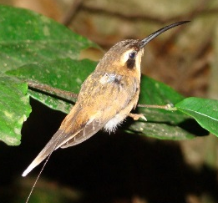
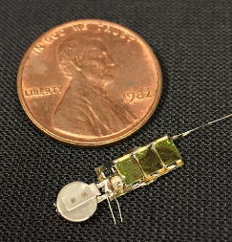
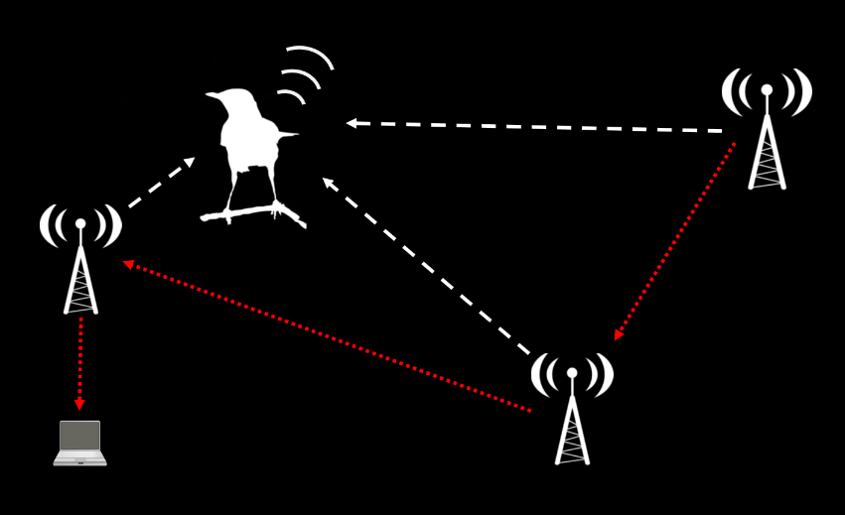
AMRUPT (Animal Movement Research Using Phase-based Trilateration)

Slide 2
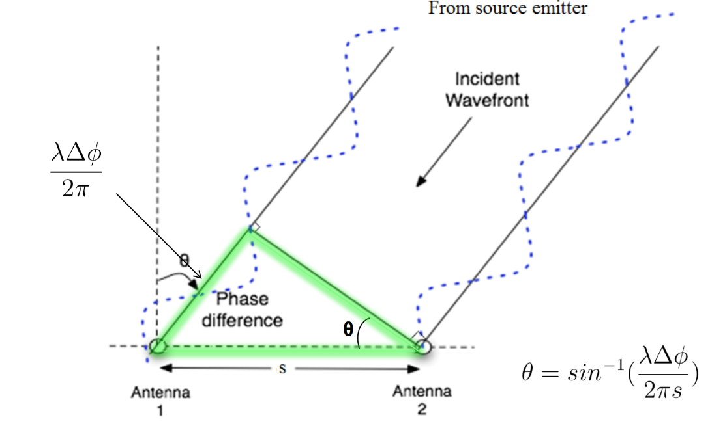
AMRUPT (Animal Movement Research Using Phase-based Trilateration)
Tracking animals for long periods of time, non-invasively, and with high-precision is challenging, but important
Existing techniques inadequate
AMRUPT attempts to solve these problems using “phase interferometry”

Slide 3
Animal Movement Research Using Phase-based Trilateration
(AMRUPT)
-Help design cutting-edge radio electronics for wildlife movement research-
Spring, 2018
Location: 233 Phillips Hall
Weekly meeting time: Tuesdays 4:30 – 5:30 PM
Co-Instructor: Dr. Julian Kapoor vak9@cornell.edu, (408) 316-3148
Co-Instructor: Dr. Joe Skovira jfs9@cornell.edu

Slide 4
Aims and Outcomes
Develop new skillsets
Learn to communicate
Work on a real-world problem
Publish your work

Slide 5
Expectations
This is a design project!!
Take the initiative
Communicate well and often
Read datasheets closely
Translate non-technical requests into efficient technical solutions
Document your work
Challenge others’ assumptions and assertions
Voice your confusion

Slide 6
Assignments
Project work
Weekly reports
Weekly discussions
Project proposal
Project report

Slide 7
Project Format and Requirements
1. Project work
Phase I of the project: basic direction-finding
Individual responsibilities, group outcomes
Individual milestones for work
DOCUMENTATION!
“Read Me” text files for code or empirical test results
In-line comments
Upload everything to GitHub repository: AMRUPT

Slide 8
Project Format and Requirements
2. Weekly reports
Miss no more than 3!!
Format
Goals
Problems/challenges
General approach to solve problem(s)
Code-level attempts at solutions, empirical tests
Planned course of action for the following week
Resources/Forum posts
Example/Template on Blackboard

Slide 9
Project Format and Requirements
3. Weekly discussions
Miss no more than 3!!
Checkpoints to evaluate progress and do “course corrections.”
Discuss relevant primary literature
Come on time and prepared to contribute
Participate actively in discussions (No coding!)

Slide 10
Project Format and Requirements
4. Proposal (Due Feb 20th)
Group proposal
Format
Statement of the problem
Objectives
Plan of Action
Management Plan (Gantt chart)

Slide 11
Gantt Chart
Task Assignments

Slide 12
Project Format and Requirements
4. Proposal (Due Feb 20th)
Group proposal
Format
Statement of the problem
Objectives
Plan of Action
Management Plan (Gantt chart)
Deliverables
Resource Requirements
Bibliography
Example/Template on Blackboard
Contract detailing what you will do in the semester!!

Slide 13
Project Format and Requirements
5. Project Report & Oral Presentation
Individual report
Report format
Executive Summary
Introduction / Literature Review / State of the Art
Design Requirements and Considerations (high level)
Design Implementation

Slide 14
State machines
Schematics
Flowcarts
Software structure
Board layouts

Slide 15
Project Format and Requirements
5. Project Report & Oral Presentation
Individual report
Report format
Executive Summary
Introduction / Literature Review / State of the Art
Design Requirements and Considerations (high level)
Design Implementation
Test Results / Performance
Conclusions
Acknowledgements
Bibliography
Appendices
*Upload materials to GitHub!
Oral presentation
M. Eng. Poster Session

Slide 16
Grading
Must take AMRUPT project for letter grade
Dr. Skovira and Dr. Kapoor will be grading jointly
Grade calculations:
Project proposal (30%)
Weekly progress reports and attendance (20%)
End-of-semester project report (50%)
35% for written report
15% for oral presentation

Slide 17
Integrity
Absolute integrity is expected of every Cornell student!

Slide 18
Questions…

Slide 19
Step 1: Begin planning for the design process
Khandani, 2005

Slide 20
Step 1: Begin planning for the design process
Khandani, 2005

Slide 21
Define the problem
1. Identify and establish the need
“A common tendency is to begin generating a solution to an apparent problem without understanding the problem.”
2. Develop a problem statement
“To reach a clear definition, [engineers] collect data, run experiments, and perform computations that allow a need to be expressed as part of an engineering problem-solving process.”
3. Establish explicit criteria for success
The design must collect accurate data.
The design must collect sufficiently precise data.
The design must be fast.
The design must be low cost.
The design should be safe.
The design should be simple to operate, with minimum human effort.

Slide 22
Engineering design process
Khandani, 2005

Slide 23
Gather pertinent information
1. Refine your thinking about the problem, and place it in context
Is the problem real and its statement accurate?
Is there really a need for a new solution or has the problem already been solved?
What are the existing solutions to the problem?
What is wrong with the way the problem is currently being solved?
What is right about the way the problem is currently being solved?
2. Search for information sources
Scientific encyclopedias and technical handbooks.
Primary articles
Faculty in ECE and beyond
Company websites and brochures

Slide 24
Engineering design process
Khandani, 2005

Slide 25
Generate multiple solutions
Synthesize ideas from existing work
“Start with existing solutions to the problem and then tear them apart to find out what's wrong with those solutions and focus on how to improve their weaknesses.”
Brainstorming important!!
“Ideas are generated when people are free to take risks and make mistakes.”
“Brainstorming at this stage is often a team effort in which people from different disciplines are involved in generating multiple solutions to the problem.”

Slide 26
Engineering design process
Khandani, 2005

Slide 27
Analyze and select a solution
1. Systematic analysis of design solutions
Functional analysis – will it function the way it should?
Mechanical/Strength analysis – is it physically durable?
Manufacturability/Testability – can it be produced easily? Is it overly complex?
Product safety and liability – will it be safe for the user?
Economic and market analysis – is it affordable / cost-effective?
Regulatory and Compliance – is it legal (think about FCC regulations)?
2. The decision process: how to choose among the options?
Think about using a decision matrix:
Functionality: 30 %
Cost: 20 %
Complexity: 20 %
Safety: 20 %
Use of standard parts: 10 %
A | B | C
25 | 30 | 15
20 | 15 | 20
10 | 20 | 20
20 | 20 | 20
5 | 10 | 5
A | B | C
25 | 30 | 15
20 | 15 | 20
10 | 20 | 20
20 | 20 | 20
5 | 10 | 5
80 | 95 | 80

Slide 28
Engineering design process
Khandani, 2005

Slide 29
Test and implement the solution
1. Prototyping
Simulations and simplified models to evaluate if you’re on the right track. Help define what other considerations may be need to be met before getting too far.
2. Documentation (!!!!)
“One of the most important activities in design is documenting your work, clearly communicating the solution to your design problem so someone else can understand what you have created.”

Slide 30

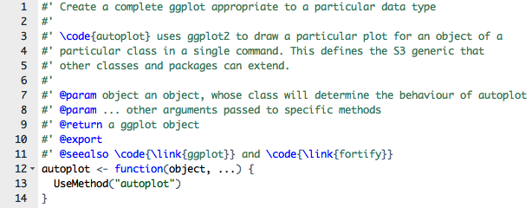
Good documentation is essential!
“ReadMe”file
In-line comments

Slide 31
Test and implement the solution
1. Prototyping
Simulations and simplified models to evaluate if you’re on the right track. Help define what other considerations may be need to be met before getting too far.
2. Documentation (!!!!)
“One of the most important activities in design is documenting your work, clearly communicating the solution to your design problem so someone else can understand what you have created.”
3. Testing and verification
Without proper testing at all stages in the process, you may find yourself making costly mistakes later.
Standardized test sets to evaluate functionality across semesters

Slide 32
Engineering design process
Define the AMRUPT Problem
Project Proposal
Khandani, 2005

Slide 33
For next week
Read:
“Engineering design process”
AMRUPT project description
Prepare:
“Consultation” with me (Julian) to obtain pertinent information in generating a proposal for this semester’s work.
Generate list of questions to help you define the problem, and to gather background information

Slide 35
AMRUPT
Basic description

Slide 36
Requirements and constraints
Short range (100-300 m between receivers)
Extremely simple transmitter design (lightweight, low power)
System can operate in cluttered environments (multipath interference)
System can operate with ~50 Txers
High spatial accuracy (~5 m) triangulation results
Low cost receivers (COTS components)
Low power consumption of receivers

Slide 37
Local
Oscillator
I/Q 1
Antenna 1
LNA
RF Switch
CC1310
Watson-Watt pair 1
Antenna 2
LNA
I/Q 2
I/Q 1-4,
RSSI 1-4, ID
DF Algorithm running on RaspberryPi
Antenna 3
LNA
I/Q 3
Watson-Watt pair 2
AOA,
RSSI,
ID,
Time
Antenna 4
LNA
I/Q 4
Notes:
TDOA

Slide 38
signal
RF in
CC1310
ID out
control
Trigger
LNA
Local Oscillator
ADC
DF Algorithm running on RaspberryPi
Antenna 1
1
2
Watson-Watt pair 1
3
LNA
4
Antenna 2
I
I/Q
Antenna 3
LNA
Q
1
Watson-Watt pair 2
2
LNA
Demodulator
&
IF Mixer
3
Antenna 4
4
Notes:
TDOA

Slide 39
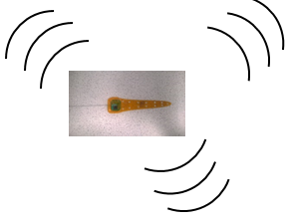

TRX 1
Automated phase-based telemetry receiver system
TRX 2
Local
Oscillator
Local
Oscillator
Antenna 1
Low Noise
Amplifier
CC1310 1
Antenna 1
Low Noise
Amplifier
CC1310 1
Antenna 2
Low Noise
Amplifier
CC1310 2
DF Algorithm running on RaspberryPi
Antenna 2
Low Noise
Amplifier
CC1310 2
DF Algorithm running on RaspberryPi
Antenna 3
Low Noise
Amplifier
CC1310 3
Antenna 3
Low Noise
Amplifier
CC1310 3
Antenna 4
Low Noise
Amplifier
CC1310 4
Antenna 4
Low Noise
Amplifier
CC1310 4
GPS
RxTx communication protocol
Compass
Energy harvesting
Time-keeping,
coordination w/txrs
coordination w/ rxrs
localization of receivers
Orienting antenna elements
Node-to-node VHF uplink
TRX3
Trilateration algorithm
Uses RSSI?
Machine learning w/ calibration beacons?
TRX4
Local
Oscillator
Bluetooth / VHF uplink to central hub
Local
Oscillator
Antenna 1
Low Noise
Amplifier
CC1310 1
Antenna 1
Low Noise
Amplifier
CC1310 1
Antenna 2
Low Noise
Amplifier
CC1310 2
DF Algorithm running on RaspberryPi
Antenna 2
Low Noise
Amplifier
CC1310 2
DF Algorithm running on RaspberryPi
Antenna 3
Low Noise
Amplifier
CC1310 3
Antenna 3
Low Noise
Amplifier
CC1310 3
Antenna 4
Low Noise
Amplifier
CC1310 4
Antenna 4
Low Noise
Amplifier
CC1310 4

Slide 40
Mobile-to-Ground Node Communication Protocol
5 + X s
5 min – (5 + X s)
Tx
Rx from mobile nodes
5 s
X (?) s
Ground node
(acquire or sleep mode)
Tx countdown signal (5 s)
Tx commands
e.g. timestamp & checksum
e.g. timestamp & checksum
0.0000
Y IDs
Y commands
*Will need a data upload mode too
Checksum (opt.)
Global time
Sleep command
Y
Sleep length
X
Listen for tags
X
Y
X
N
Default?
N
Special commands for Y tags
*Give mobile nodes way to check that they have a good link
*All mobile nodes sync’d here
*Keeps all mobile nodes from TXing when system isn’t monitoring
*Default mode just has any tag within range of sync signal transmit at its scheduled time
*Special commands allow a subset of tags to be told to go to sleep, switch to different mode (e.g. to upload sensor data on different channel), etc.
Notes:
Mobile node diagram to follow. Mobile nodes should sleep just under 5 s (ensuring they will hear a ground node transmission at least once if it is in range), then wake long enough to receive a single countdown signal from a ground node. Once they have received a countdown signal, and the checksum demonstrates a good link, update global time (it will have drifted over the last 5 min), then listen for rest of commands. Once commands received use global time, received command, and (assuming the command includes a simple transmit instruction) pre-programmed transmission time delay to send ID during the ground node’s ~5 min RX period.

Slide 41
Progress so far...
System architecture (Russell, Mei)
Datalogging (Peidong)
Wireless communication protocol (Nathan)

Slide 42
Local
Oscillator
I/Q 1
Antenna 1
LNA
RF Switch
CC1310
Watson-Watt pair 1
Antenna 2
LNA
I/Q 2
I/Q 1-4,
RSSI 1-4, ID
DF Algorithm running on RaspberryPi
Antenna 3
LNA
I/Q 3
Watson-Watt pair 2
AOA,
RSSI,
ID,
Time
Antenna 4
LNA
I/Q 4
Notes:
TDOA

Slide 43
Mobile-to-Ground Node Communication Protocol
5 + X s
5 min – (5 + X s)
Tx
Rx from mobile nodes
5 s
X (?) s
Ground node
(acquire or sleep mode)
Tx countdown signal (5 s)
Tx commands
e.g. timestamp & checksum
e.g. timestamp & checksum
0.0000
Y IDs
Y commands
*Will need a data upload mode too
Checksum (opt.)
Global time
Sleep command
Y
Sleep length
X
Listen for tags
X
Y
X
N
Default?
N
Special commands for Y tags
*Give mobile nodes way to check that they have a good link
*All mobile nodes sync’d here
*Keeps all mobile nodes from TXing when system isn’t monitoring
*Default mode just has any tag within range of sync signal transmit at its scheduled time
*Special commands allow a subset of tags to be told to go to sleep, switch to different mode (e.g. to upload sensor data on different channel), etc.
Notes:
Mobile node diagram to follow. Mobile nodes should sleep just under 5 s (ensuring they will hear a ground node transmission at least once if it is in range), then wake long enough to receive a single countdown signal from a ground node. Once they have received a countdown signal, and the checksum demonstrates a good link, update global time (it will have drifted over the last 5 min), then listen for rest of commands. Once commands received use global time, received command, and (assuming the command includes a simple transmit instruction) pre-programmed transmission time delay to send ID during the ground node’s ~5 min RX period.

